Slide 1
CSE1142 – Functions in C
Adapted from Dr. Sanem Arslan Yılmaz.
Some of the slides are from: CMPE150 – Boğaziçi University, Deitel & Associates.
Notes:
- Experience has shown that the best way to develop and maintain a large program is to construct it from smaller pieces or modules, each of which is more manageable than the original program.
- This technique is called divide and conquer.

Slide 2
Agenda
Functions
  Definition
  Syntax
  Input/output
Function Prototypes
Function Call Stack
Scope and lifetime of variables
Local vs. global variables
Macro Substitution
Value parameters (call by value)
Variable parameters (call by reference)
Recursive Functions
Standart Functions in C

Slide 3
Functions - Definition
A function groups a set of related statements under a single title.
You can "call" the function using its name.
You may also provide parameters to the function during the call.
A function performs the actions defined by its statements and returns a result.

Slide 4
Functions - Syntax
Syntax:
  return_type function_name (parameter_list)
  { local_variable_definitions
  statement(s)
  }
Functions operate on their parameters and produce results.
  The result is returned via the return value.
The parameters may or may not be altered by the function.
If return_type is missing, it means int.

Slide 5
Example
Consider the polynomial P(x) = 8x⁵ + 5x⁴ + 6x³ + 3x² + 4x + 2
Read a value for x and display the result.

Slide 6
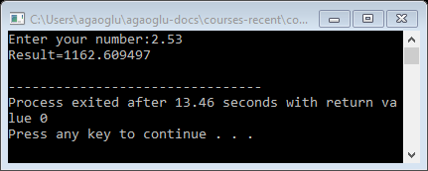
Example: Solution with functions
  #include <stdio.h>
  /* Calculate a^b */
  float power(float a, int b){
  float result=1;
  for (; b>0; b--)
  result *= a;
  return result;
  }
  int main(){
  float P_x, x;
  scanf("%f", &x);
  P_x = 8 * power(x,5) + 5 * power(x,4) + 6 * power(x,3) +
  3 * power(x,2) + 4 * x + 2;
  printf("Result=%f\n", P_x);
  return 0;
  }
Notes:
- Run C23_10_power.c.

Slide 7
Functions – Caller and Callee
A function that is being called is named callee.
The function from which the call is made is named caller.
In the previous example, main() is the caller, power() is the callee.

Slide 8
Example: Solution with functions II
  #include <stdio.h>
  float power(float a, int b);
  int main(){
  float P_x, x;
  scanf("%f", &x);
  P_x = 8 * power(x,5) + 5 * power(x,4) + 6 * power(x,3) +
  3 * power(x,2) + 4 * x + 2;
  printf("Result=%f\n", P_x);
  return 0;
  }
  /* Calculate a^b */
  float power(float a, int b){
  float result=1;
  for (; b>0; b--)
  result *= a;
  return result;
  }
Function prototype
Notes:
- Run C23_10_power.c.

Slide 9
Function Prototypes
An important feature of C is the function prototype.
The compiler uses function prototypes to validate function calls.
  The following prototype states that power takes two arguments of type float and int and returns a result of type float.
    float power(float a, int b);
Notice that the function prototype is the same as the first line of power’s function definition.
Include parameter names in function prototypes for documentation purposes.
  The compiler ignores these names, so the prototype float power(float, int); is also valid.
  Forgetting the semicolon at the end of a function prototype is a syntax error.

Slide 10
Function Prototypes (cont.)
A function call that does not match the function prototype is a compilation error.
If there is no function prototype for a function before its use in main function, it leads to warnings or errors, depending on the compiler.
  Since C is a single-pass language.
  The compiler does not look ahead to see the definition of a function or variable.
  The declaration of a function must come before the use of the function, otherwise the compiler does not know what its type signature is.

Slide 11
Functions – Input & Outputs
We will cover functions in the following order:
  Void functions
  Functions without parameters
  Functions with parameters
  Functions that return a value
  Functions that alter their parameters

Slide 12
Example: power() function with parameters
  float power(float a, int b)
  {
  float result=1;
  for (; b>0; b--)
  result *= a;
  return result;
  }

Slide 13
Function Call Stack
To understand how C performs function calls, we first need to consider a data structure (i.e., collection of related data items) known as a stack.
Think of a stack as analogous to a pile of dishes.
When a dish is placed on the pile, it’s normally placed at the top (referred to as pushing the dish onto the stack).
Similarly, when a dish is removed from the pile, it’s normally removed from the top (referred to as popping the dish off the stack).
Stacks are known as last-in, first-out (LIFO) data structures—the last item pushed (inserted) on the stack is the first item popped (removed) from the stack.

Slide 14
Function Call Stack (cont.)
An important mechanism for computer science students to understand is the function call stack (sometimes referred to as the program execution stack).
It supports the function call/return mechanism.
Each time a function calls another function, an entry is pushed onto the stack.
If a function makes a call to another function, a stack frame for the new function call is simply pushed onto the call stack.
If the called function returns, instead of calling another function before returning, the stack frame for the function call is popped.

Slide 15
Function Call Stack (cont.)
The called function’s stack frame is a perfect place to reserve the memory for local variables.
That stack frame exists only as long as the called function is active.
When that function returns, its stack frame is popped from the stack, and those local variables are no longer known to the program.
Of course, the amount of memory in a computer is finite, so only a certain amount of memory can be used to store stack frames on the function call stack.
If more function calls occur than can have their stack frames stored on the function call stack, a fatal error known as a stack overflow occurs.

Slide 16
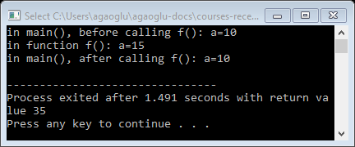
Changes in parameters are not reflected
#include <stdio.h>
void f(int a)
{
a+=5;
printf("in function f(): a=%d\n", a);
}
int main()
{ int a=10;
printf("in main(), before calling f(): a=%d\n",a);
f(a);
printf("in main(), after calling f(): a=%d\n",a);
}
f()
a
10
15
OUTPUT
main()
a
10
in main(), before calling f(): a=10
in function f(): a=15
Stack
in main(), after calling f(): a=10
Notes:
- Run C23_15_paramByValue.c, if required.

Slide 17
Scope of variables
A local variable can be used only in the function where it is defined
  i.e., the scope of a local variable is the current function.
A global variable can be used in all functions below its definition
  i.e., the scope of a global variable is the range from the variable definition to the end of the file.

Slide 18
Lifetime of variables
The lifetime of a variable depends on its scope.
A local variable is alive as long as the function where it is defined is active.
  When the function terminates, all of the local variables (and their values) are lost.
  When the function is called again, all variables start from scratch; they don’t continue with their values from the previous call (except for local static variables which are not discussed).
The lifetime of a global variable is equivalent to the lifetime of the program.

Slide 19
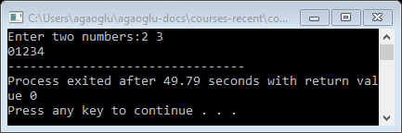
Scope and lifetime of variables
#include <stdio.h>
int count;
int func(){
int i, j;
printf("Enter two numbers:");
scanf("%d %d", &i, &j);
count += i+j;
return 0;
}
int main(){
int i;
func();
for (i=0; i<count; i++)
printf("%d",i);
return 0;
}
Notes:
- Run c23_20_scopeLocGlb.c.

Slide 20
Global vs. local variables
Global variables | Local variables
Visible in all functions | Visible only within the function they are defined
Zero by default | Uninitialized
A change made by a function is visible everywhere in the program | Any changes made on the value are lost when the function terminates (since the variable is also removed)
Scope extends till the end of the file | Scope covers only the function
Lifetime spans the lifetime of the program | Lifetime ends with the function

Slide 21
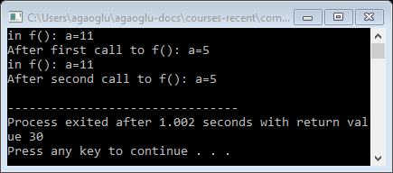
Changing local variables
Any change made on local variables is lost after the function terminates.
  void f()
  { int a=10;
  a++;
  printf("in f(): a=%d\n",a);
  }
  int main()
  { int a=5;
  f();
  printf("After first call to f(): a=%d\n",a);
  f();
  printf("After second call to f(): a=%d\n",a);
  }
Notes:
- Run C23_25_localVar.c.

Slide 22

Changing global variables
Any change made on global variables remains after the function terminates.
  int b;
  void f()
  {
  b++;
  printf("in f(): b=%d\n",b);
  }
  int main()
  {
  f();
  printf("After first call to f(): b=%d\n",b);
  f();
  printf("After second call to f(): b=%d\n",b);
  }
Notes:
- Run C23_30_globalVar.c.

Slide 23
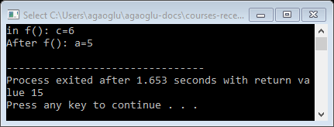
Changing value parameters
Any change made on value parameters is lost after the function terminates.
  void f(int c)
  {
  c++;
  printf("in f(): c=%d\n",c);
  }
  int main()
  { int c=5;
  f(c);
  printf("After f(): c=%d\n",c);
  }
Notes:
- Run C23_35_paramValChange.c.

Slide 24
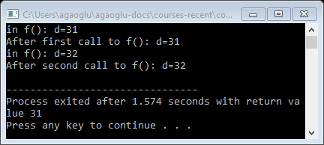
Local definition veils global definition
A local variable with the same name as the global variable veils the global definition.
  int d=10;
  void f()
  {
  d++;
  printf("in f(): d=%d\n",d);
  }
  int main()
  { int d=30;
  f();
  printf("After first call to f(): d=%d\n",d);
  f();
  printf("After second call to f(): d=%d\n",d);
  }
Notes:
- Run C23_40_localVeilsGlobal.c.

Slide 25
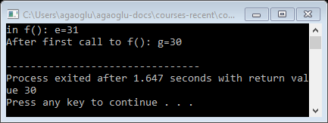
Parameter definition veils global definition
Similar to local variables, parameter definition with the same name as the global variable also veils the global definition.
  int e=10;
  void f(int e)
  {
  e++;
  printf("in f(): e=%d\n",e);
  }
  int main()
  { int g=30;
  f(g);
  printf("After first call to f(): g=%d\n",g);
  }
Notes:
- Run C23_45_paramVeilsGlobal.c.

Slide 26
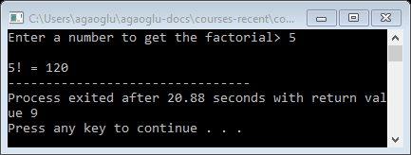
Example
Write a function that calculates the factorial of its parameter.
  n! = n(n-1)(n-2)...1
  long factorial(int n)
  {
  int i;
  long res = 1;
  if (n == 0)
  return 1;
  for (i = 1; i <= n; i++)
  res *= i;
  return res;
  }
Notes:
- Run C23_50_factorialByIteration.c.

Slide 27
Macro Substitution
Remember
    #define PI 3.14
It is also possible to write macros with parameters.
    #define square(x) x*x
  The name of the macro is square.
  Its parameter is x.
  It is replaced with x*x (with paramater x substituted.)

Slide 28
Defining Macros with Parameters
macro
  facility for naming a commonly used statement or operation
macro expansion
  process of replacing a macro call by its meaning

Slide 29
Macro Substitution
#define square(x) x*x
Note that when the macro is called as
    square(a+1)
  the substituted form will be
    a+1*a+1
  which is not correct.
The macro should have been defined as
    #define square(x) (x)*(x)
  so that its substituted form would be
    (a+1)*(a+1)

Slide 30
Macro Substitution
A macro is NOT a function.
  A macro is implemented as a substitution.
    ▪ The code segment that implements the macro substitutes the macro call.
    + Code executes faster.
    - Code becomes larger.
    + It is possible to do things that you cannot do with functions.
    - Limited syntax check (Remember the "square(a+1)" example).
  A function is implemented by performing a jump to a code segment.
    ▪ Stack operations are performed for function call.
    - Code executes slower.
    + Code is smaller.
    + More structured programming.
    + Better syntax check.
Notes:
- Of course, since the macro’s meaning appears in the program at every call, the object file produced by the compiler typically requires more memory than the same program would require if it used a function rather
than a macro.

Slide 31
Example: Macro substitution
Define a macro for finding the maximum of two values.
#define max(A,B) (((A)>(B))?(A):(B))
Find the maximum of three numbers. Four numbers?
result=maximum(a, b, c);
int maximum(int x, int y, int z){
int max_num=x;
if(max_num < y)
max_num=y;
if(max_num < z)
max_num=z;
return max_num;
}
temp=max(a,b);
result=max(temp,c);
temp1=max(a,b);
temp2=max(c,d);
result=max(temp1,temp2);

Slide 32
Example: Macro substitution
Define a macro for finding the absolute value.
  #define abs(A) ((A)>0)?(A):-(A))

Slide 33
Variable Parameters

Slide 34
Value parameters – Call by value
We used "value parameters" up to now.
We did not pass the variable in the argument; we passed the value of the expression in the argument.
  That is why the changes made on the parameter were not reflected to the variable in the function call.

Slide 35
Variable parameters
Sometimes, the caller may want to see the changes made on the parameters by the callee.
  E.g.:int main()
        { int num;
        scanf("%d", &num);
        }
  You expect scanf() to "put" the input in the variable num, but this is not possible with value parameters.
  (It is possible to return a single value using the return type; so it is not practical enough. Also, you should use the same variable both as an argument and for the return value.)

Slide 36
Pointer variable definitions and initialization
Pointer variables
  Contain memory addresses as their values
  Normal variables contain a specific value (direct reference)
  Pointers contain address of a variable that has a specific value (indirect reference)
  Indirection – referencing a pointer value
count
7
countPtr
count
7

Slide 37
Pointer variable definitions and initialization – cont.
Pointer definitions
  * used with pointer variables
      int *myPtr;
  Defines a pointer to an int (pointer of type int *)
  Multiple pointers require using a * before each variable definition
      int *myPtr1, *myPtr2;
  Can define pointers to any data type
  Initialize pointers to 0, NULL, or an address
    0 or NULL – points to nothing (NULL preferred)

Slide 38
Pointer Operators
& (address operator)
  Returns address of operand
    int y = 5;
    int *yPtr;
    yPtr = &y; /* yPtr gets address of y */
    yPtr “points to” y
y
yptr
y
yPtr
5
500000
600000
600000
5
Address of y is value of yptr

Slide 39
Pointer Operators – cont.
* (indirection/dereferencing operator)
  Returns a synonym/alias of what its operand points to
  *yptr returns y (because yptr points to y)
  * can be used for assignment
    Returns alias to an object
      *yptr = 7; /* changes y to 7 */
* and & are inverses
  They cancel each other out

Slide 40
Variable parameters
Define the parameter as pointer
*
*
Use '*' before the parameter name so that you access the value at the mentioned address
&
Send the address of the argument
Converting a value parameter to a variable parameter is easy.
  void func(int num)
  { num = 5;
  }
  int main()
  { int count=10;
  func( count);
  }

Slide 41
Call by reference
The idea is very simple actually:
  When a function terminates everything inside the stack entry for that function is erased.
  Therefore, if you want the changes to remain after the function call, you should make the change outside the function's stack entry.
  Here is what you do:
    At the caller instead of sending the value, send the reference (address), i.e. a pointer.
    At the callee, receive the address (i.e., define the parameter as a pointer).
    Inside the callee, use a de-referencer ('*') with the parameter name since the parameter contains the address, not the value.

Slide 42
Call by reference
This is why:
  "using value parameters" is also called "call by value"
  "using variable parameters" is also called "call by reference"

Slide 43
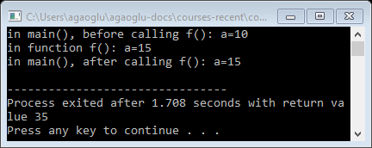
Variable parameters
#include <stdio.h>
void f(int *a)
{
*a+=5;
printf("in function f(): a=%d\n", *a);
}
int main()
{ int a=10;
printf("in main(), before calling f(): a=%d\n",a);
f(&a);
printf("in main(), after calling f(): a=%d\n",a);
}
f()
a
OUTPUT
main()
a
15
10
in main(), before calling f(): a=10
in function f(): a=15
Stack
in main(), after calling f(): a=15
Notes:
- Run C23_55_varParam.c.

Slide 44
Example
Write a function that exchanges its parameters.
Solution 1:
  void swap(int a, int b)
  {
  a=b;
  b=a;
  }
  WRONG!

Slide 45
Example
Solution 2:
  void swap(int *a, int *b)
  {
  *a=*b;
  *b=*a;
  }
  STILL WRONG!

Slide 46
Example
Solution 3:
  void swap(int *a, int *b)
  {
  int temp;
  temp = *a;
  *a=*b;
  *b=temp;
  }

Slide 47
Recursion
Recursive functions
  Functions that call themselves
  Can only solve a base case
  Divide a problem up into
    What it can do
    What it cannot do
      What it cannot do resembles original problem
      The function launches a new copy of itself (recursion step) to solve what it cannot do
  Eventually base case gets solved
    Gets plugged in, works its way up and solves whole problem
Notes:
The function actually knows how to solve only the simplest case(s), or so-called base case(s).
If the function is called with a base case, the function simply returns a result.
If the function is called with a more complex problem, the function divides the problem into two pieces: What it can do and a piece that it does not know how to do.
The latter piece is similar to the original problem, but be a slightly simpler or smaller version.
This is referred to as a recursive call or the recursion step.
The recursion step also includes the keyword return because its result will be combined with the portion of the problem the function knew.

Slide 48
Recursion – Example
Example: factorials
  5! = 5 * 4 * 3 * 2 * 1
  Notice that
    5! = 5 * 4!
    4! = 4 * 3! ...
  Can compute factorials recursively
  Solve base case (1! = 0! = 1) then plug in
    2! = 2 * 1! = 2 * 1 = 2;
    3! = 3 * 2! = 3 * 2 = 6;

Slide 49
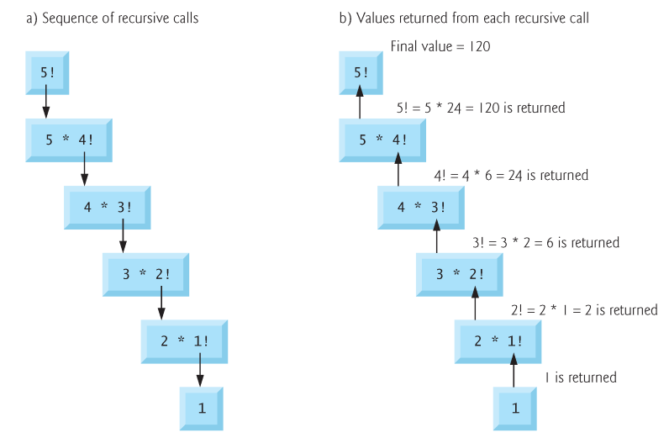
Recursion – Sequence of calls and returns

Slide 50
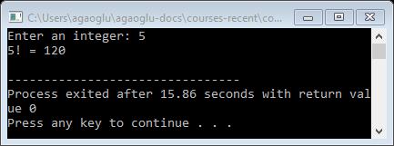
Recursion – Factorial code
  #include <stdio.h>
  long factorial(int n)
  {
  if (n>0)
  return n*factorial(n-1);
  else if (n==0)
  return 1;
  return 0;
  }
  int main()
  {
  int n;
  printf("Enter an integer: ");
  scanf("%d", &n);
  printf("%d! = %ld\n", n, factorial(n));
  return 0;
  }
Notes:
- Run C23_60_factorialByRecursion.c.

Slide 51
Example Using Recursion: The Fibonacci Series
Fibonacci series: 0, 1, 1, 2, 3, 5, 8...
  Each number is the sum of the previous two
  Can be solved recursively:
    fib( n ) = fib( n - 1 ) + fib( n – 2 )
  Code for the fibonacci function
    int fibonacci(int n)
    {
    if (n == 0 || n == 1) // base case
    return n;
    else
    return fibonacci(n - 1) + fibonacci(n – 2);
    }

Slide 52
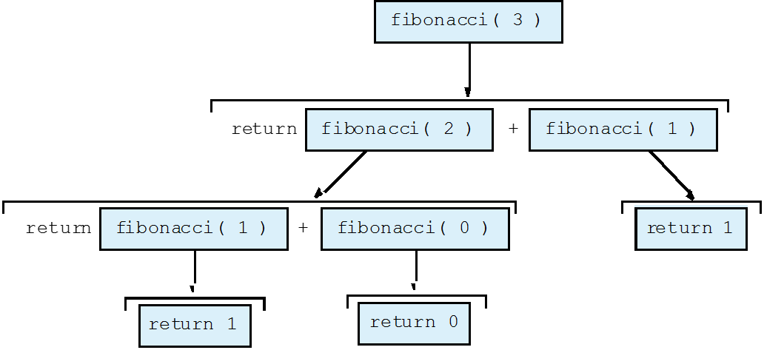
Set of recursive calls to function fibonacci

Slide 53
Recursion vs. Iteration
Repetition
  Iteration: explicit loop
  Recursion: repeated function calls
Termination
  Iteration: loop condition fails
  Recursion: base case recognized
Both can have infinite loops
Balance
  Choice between performance (iteration) and good software engineering (recursion)

Slide 54
Standart Functions in C
Math library functions
Header files
Random number generation

Slide 55
Math Library Functions
Math library functions
  perform common mathematical calculations
  #include <math.h>
Format for calling functions
  FunctionName( argument );
    If multiple arguments, use comma-separated list
  printf( "%.2f", sqrt( 900.0 ) );
    Calls function sqrt, which returns the square root of its argument
    All math functions return data type double
  Arguments may be constants, variables, or expressions

Slide 56
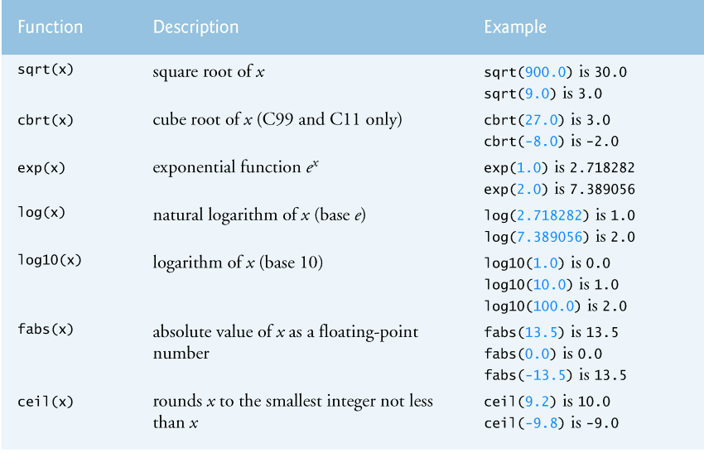
Math Library Functions

Slide 57
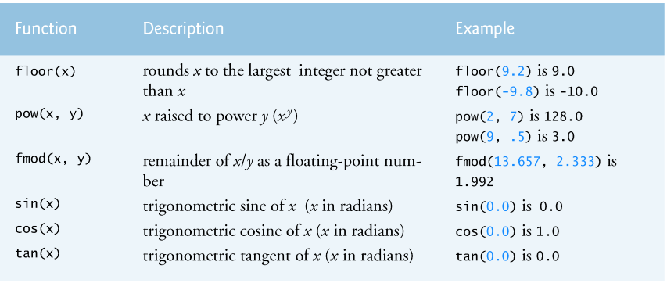
Math Library Functions (cont.)

Slide 58
Header Files
Header files
  Contain function prototypes for library functions
  <stdlib.h> , <math.h> , etc
  Load with #include <filename>
    #include <math.h>
Custom header files
  Create file with functions
  Save as filename.h
  Load in other files with #include "filename.h"
  Reuse functions

Slide 59
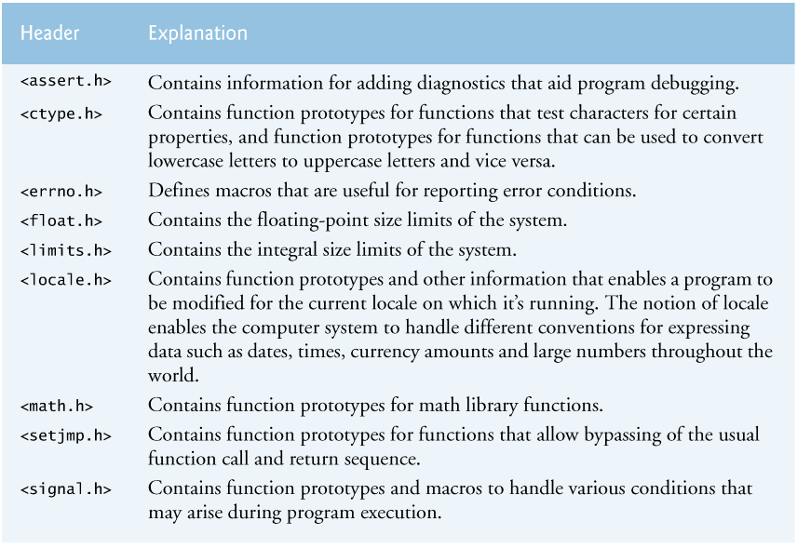
Some of the standard library headers

Slide 60
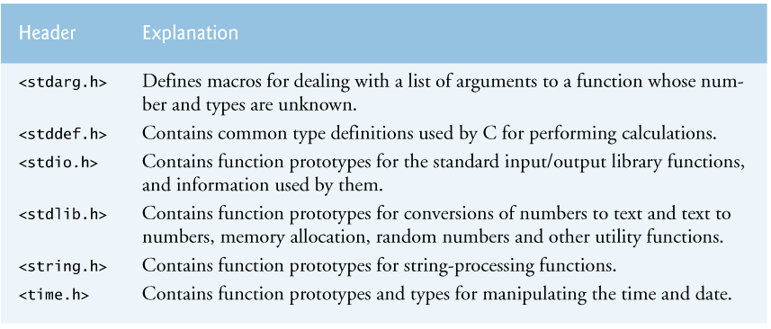
Some of the standard library headers (cont.)

Slide 61
Random Number Generation – rand function
rand function
  Load <stdlib.h>
  Returns "random" number between 0 and RAND_MAX (at least 32767)
      i = rand();
  Pseudorandom
    Preset sequence of "random" numbers
    Same sequence for every function call
Scaling
  To get a random number between 1 and n
      1 + ( rand() % n )
    rand() % n returns a number between 0 and n - 1
    Add 1 to make random number between 1 and n
      1 + ( rand() % 6)
      number between 1 and 6

Slide 62
Random Number Generation – srand function
srand function
  <stdlib.h>
  Takes an integer seed and jumps to that location in its "random" sequence
    srand( seed );
  srand( time( NULL ) );/* include <time.h> */
    time( NULL )
      Returns the time at which the program was compiled in seconds
      “Randomizes" the seed

